Slide 1














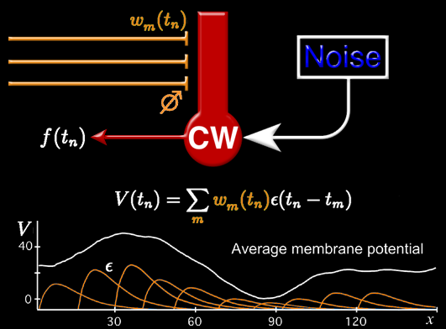















































































































Applied Mathematics in the Tech Industry
Patrick D. Roberts
Principal Data Scientist & Practice Manager
Professional Services, AI/ML Global Specialty Practice
Amazon Web Services
Mathematically Formalize Physical & Biological Principles
Find Solutions that Yield Business Value

Slide 2


Pivot from academics to industry
Background
Skills
Pivot
62 data science job applications over 2 years
Physics PhD
Computational Neuroscience Research
Pharmaceutical Consulting
Coding
Mathematics
Statistics
Business/domain expertise
Database concepts
Meetups
Data science
Business
Production
code style

Slide 3
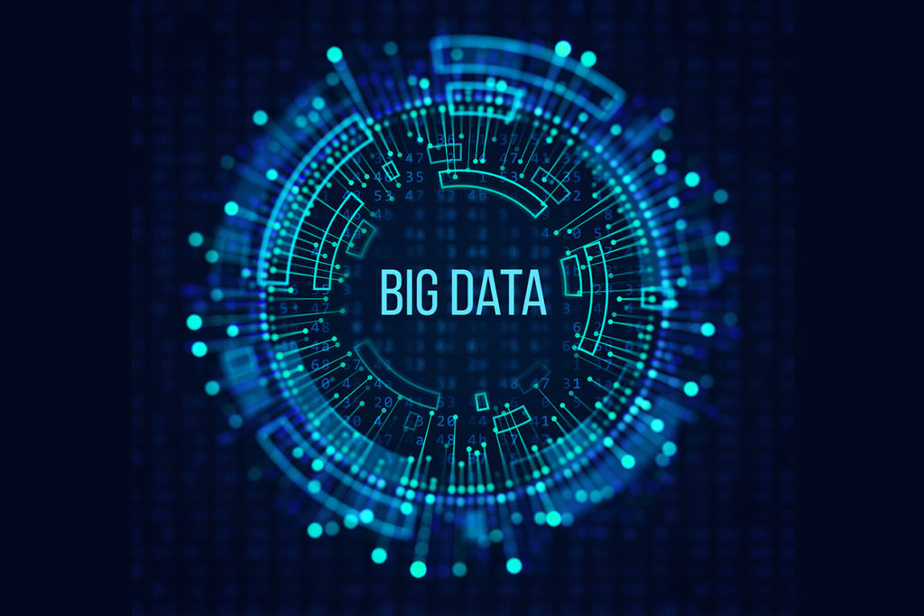
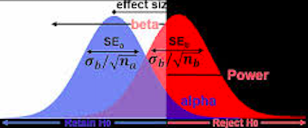






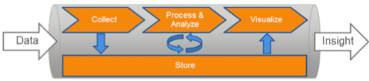
Applied Mathematics in the Tech Industry
From small to big data
Natural Language Processing & Applications
Data Science in practice

Slide 4
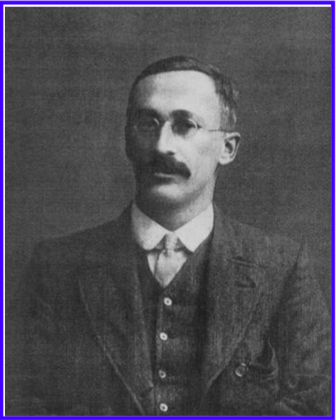
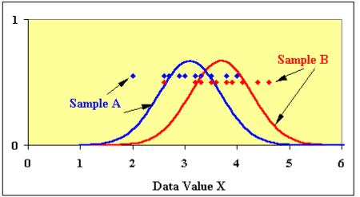
Small Data Statistics Developed in Industry
Use case: What is the smallest sample needed
for quality control of brewing ingredients?
Student’s t-test
The Probable Error of a Mean
(1908) Student, Biometrika
William S. Gosset (“Student”)
1876-1937
Master brewer at Guinness
Popularized by:
Statistical Methods for Research Workers (1925) Ronald Fisher

Slide 5

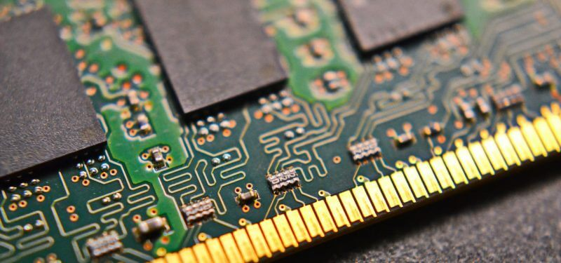


Big data, misleading statistics, and new opportunities
Data Storage
Computational Power
Failures: “Insignificant” differences become statistically significant.
Opportunities: Data sources are everywhere.
Fast feedback from model predictions drive decisions.
Circa 1620

Slide 6
Skills of the Data Scientist
Math & Statistics
Coding skills
ML
Data Scientist
Software
Analytics
Business/Domain Expertise
ML = Machine Learning

Slide 7
Artificial Intelligence and Machine Learning
Artificial Intelligence
if x & y => z
Machine Learning
Rule-based
Data-driven
Deep Learning
Complex
networks

Slide 8
Machine Learning is to Program Using Data
- Arthur Samuel (1959 )
Regression
Classifier
What color?
Feature 2
Feature 2
What value?
Feature 1
Feature 1
It’s all about the features!

Slide 9
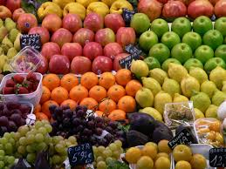

Classify Apples and Oranges
Features
color
size
weight
hardness
smoothness
juiciness
Labeled Training Data
Classifier
Hardness
apples
oranges
Color

Slide 10
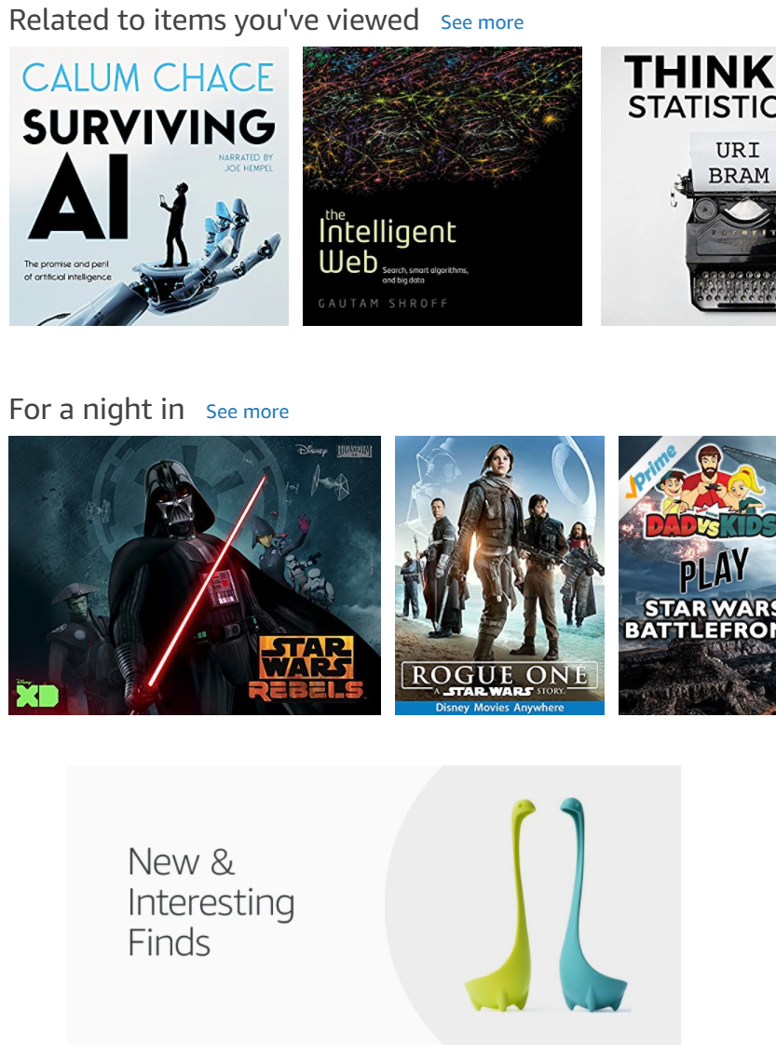
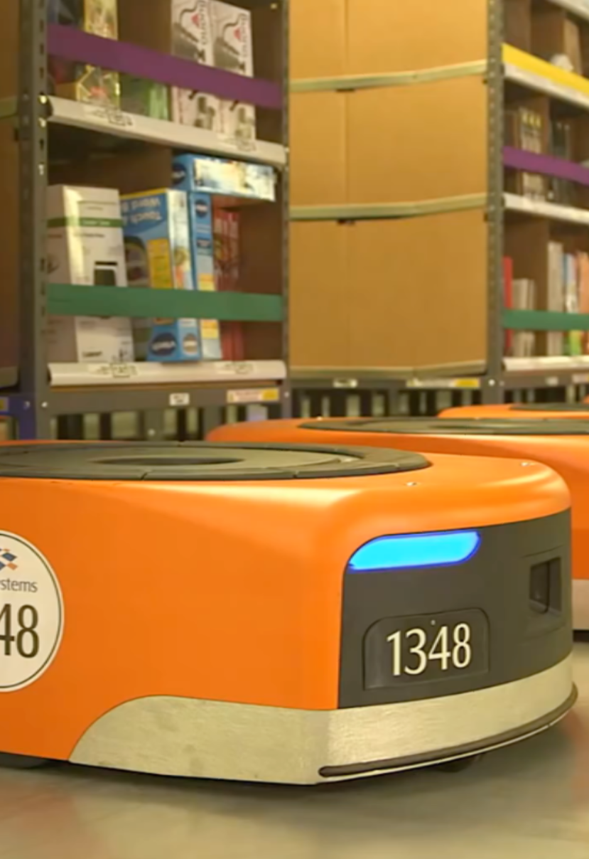
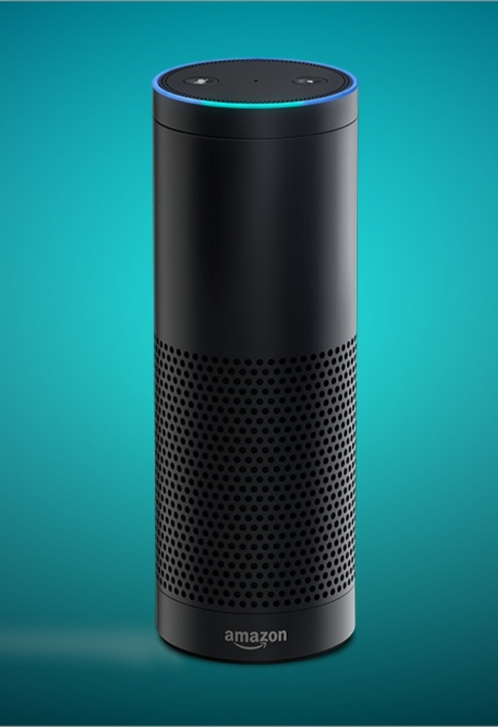
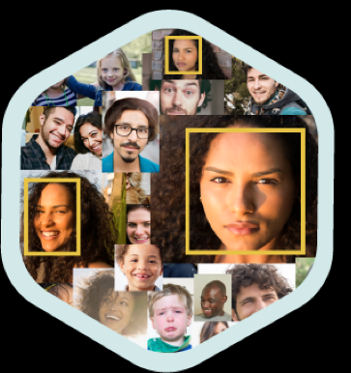
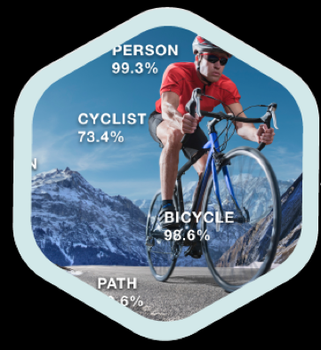
Business Use Cases for Data Science
Natural Language
Computer Vision
Search & Discovery
Robotics
Notes:
We have a large number of customers using AWS for machine learning, and we’ve been making huge investments in the space for 20 years. It’s important to remember that many of the capabilities customers experience with Amazon are driven by machine learning. Our recommendations engine is driven by ML. The paths that optimize robotic picking routes in our fulfillment centers are driven by ML. Our supply chain, forecasting, and capacity planning are informed by ML algorithms. Alexa is fueled by Natural Language Understanding and Automated Speech Recognition deep learning. Our drone initiative, Prime Air, and the computer vision technology in our new retail experience, Amazon Go, are driven by deep learning. We have thousands of engineers at Amazon committed to ML and deep learning, and it’s a big part of our heritage.

Slide 11
Applied Mathematics in the Tech Industry
From small to big data
Natural Language Processing & Applications
Data Science in practice

Slide 12
Business Use Cases for Data Science
in Natural Language Processing
Finance: Document classification
Education: Recommend major based on individual course history
Healthcare: Outcome prediction and treatments for disease

Slide 13

Financial Services – Automated Due Diligence
?
BUSINESS CHALLENGE
Support and automate investment due diligence process on financial documentation through deep natural language processing.
Classify important text in documents.
DATA
Corpus of ~1000 documents similar to the target documents (unlabeled)
Domain specific Wikipedia data (AWS sourced)
2,500 annotated pages (sections of interest highlighted using tagtog, an APN solution)
Notes:
#fsi #emea #sagemaker #UPDATEDMARCH2020 #ent @EMROBI
Siemens Financial Services (SFS) provides due diligence for energy projects undertaken by Siemens.
They needed a faster way to extract the most relevant text from financial documents for due diligence.
SFS uses TensorFlow on Amazon SageMaker to develop a natural language processing (NLP) model for investment due diligence. The model accelerates due diligence by extracting the most relevant and critical information from supporting documents.
SFS took advantage of the Blazing Text algorithm offered by Amazon SageMaker to quickly build their NLP model. With the help of the model, SFS has reduced time to summarize diligence documents from hours down to 30 seconds

Slide 14





The burden of manual data entry tasks
Excel
Accelerate with automated process

Slide 15
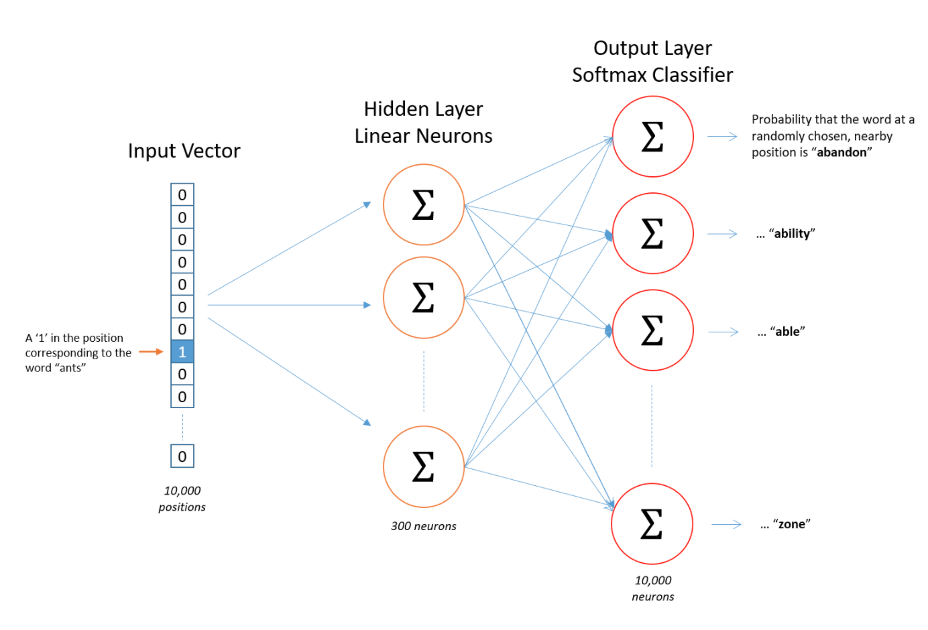
Financial Services – Automated Due Diligence
MACHINE LEARNING APPROACH
Neural network sentence classifier custom built on Amazon SageMaker
Very large feature space:
Oxford Dictionary has171,476 English words in current use.
=> Use word embeddings to reduce the feature space dimension.

Slide 16
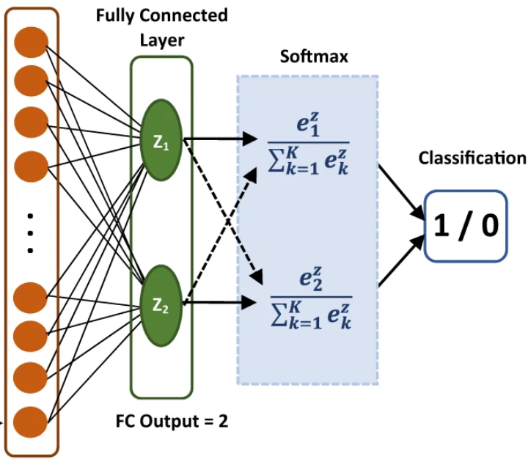
Financial Services – Automated Due Diligence
MACHINE LEARNING APPROACH
Sequences of embedded words are features for a classifier.
Input
“…
letter
of
credit
and
long
term
loan
…”
Input Layer
Embedding
Embedded Sequence
Features
Classifier

Slide 17
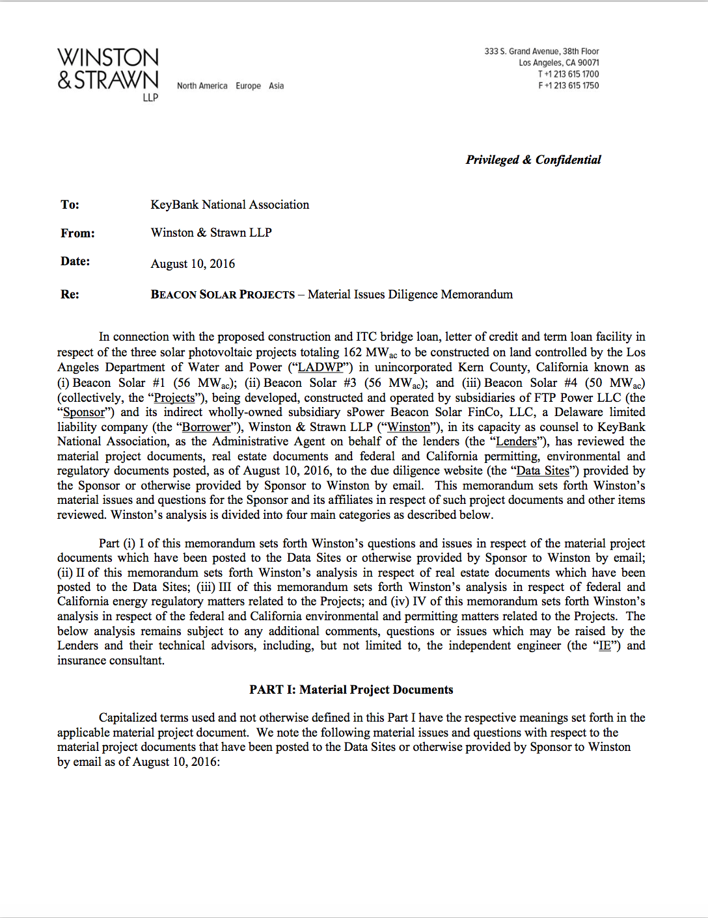
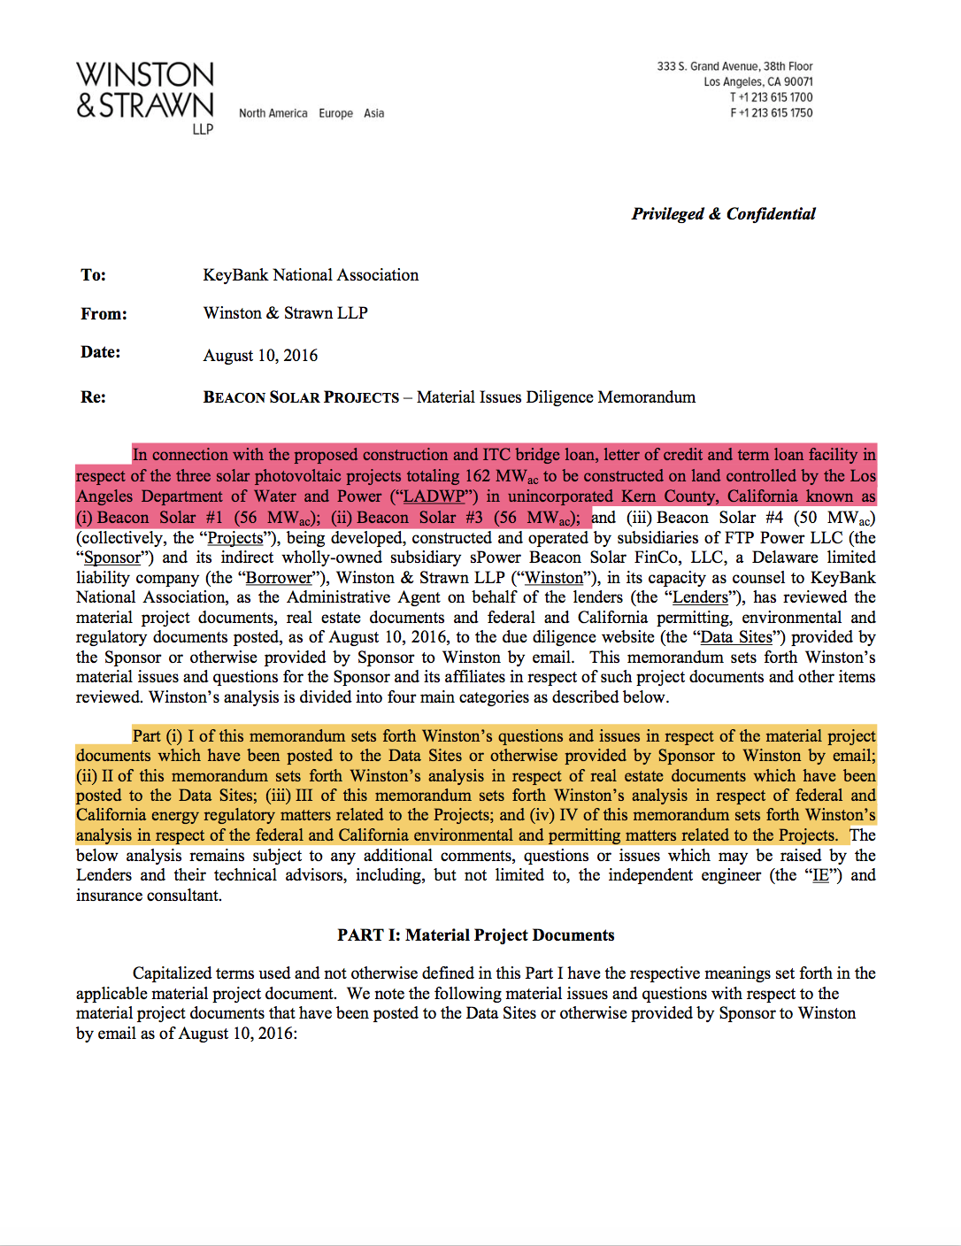
Financial Services – Automated Due Diligence
OUTCOMES
Reduced document due diligence time to summarize documents from 12 hours down to 30 seconds.
End-to-end natural language processing (NLP) platform to
Annotate PDF documents
Train deep learning NLP models
Provide feedback on machine generated annotations in an easy-to-use user interface to improve the models over time

Slide 18
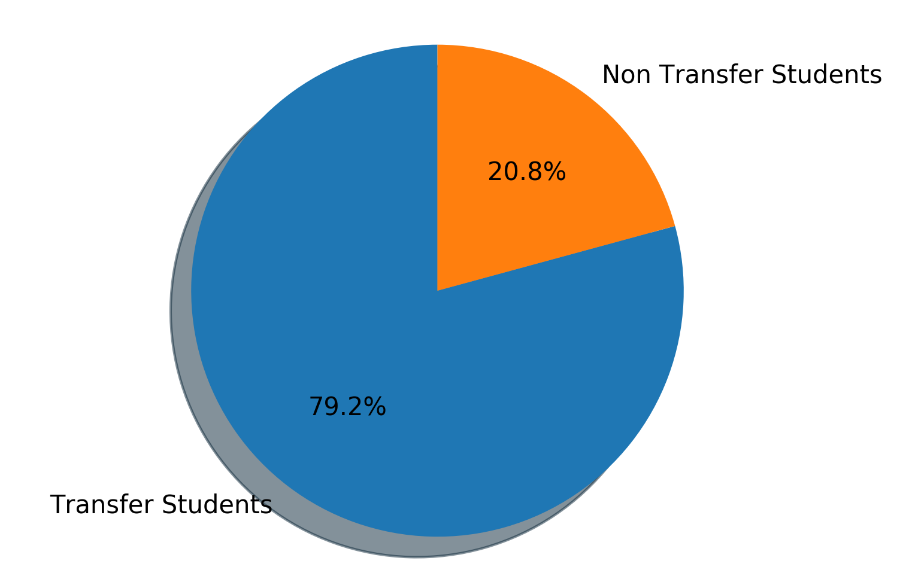
Advisory needs of PSU students, and solutions
Education - Guided Student Pathways
Portland State University
Students often need guidance to select majors,
But sorting through catalogs is tedious.
Most students at PSU are transfers,
Benefit from rank ordered major matching.

Slide 19
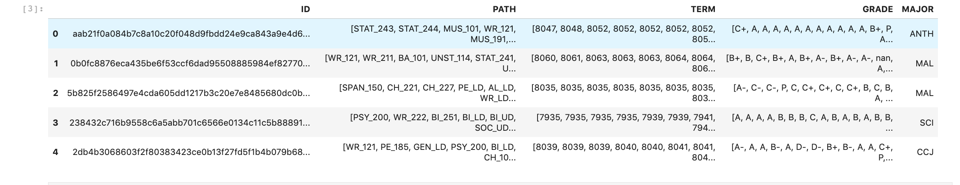
Historical Student Data
Five years of student data from Banner contains:
Anonymized ID, courses (PATH), term code, grade, and successful major.
Number of students: 21,547
Number of courses: 5,531
Number of majors: 117
Model: Use PATH to predict MAJOR

Slide 20
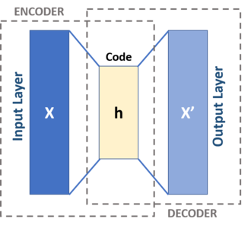
Education – Guided Student Pathways
MACHINE LEARNING APPROACH
Word embeddings compress the dimensions to preserve relationships of words.
Input
Output
“FILM_331
ART_402
UNST_421
ART_250
PHL_306
RH_204
…”
“FILM_331
ART_402
UNST_421
ART_250
PHL_306
RH_204
…”
Embedding (dim=100)

Slide 21
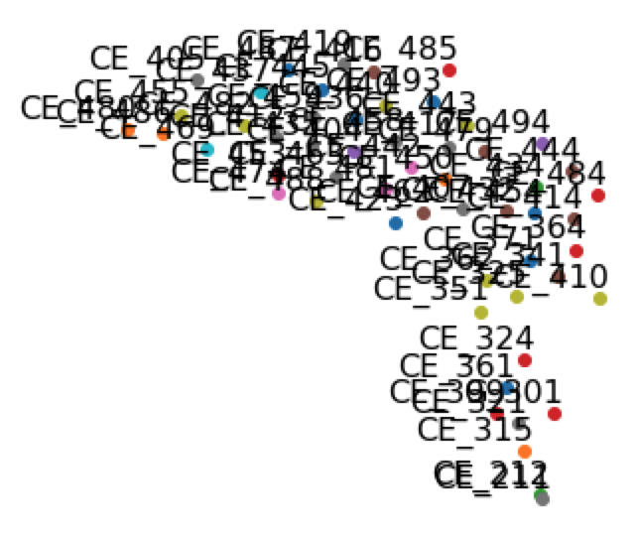
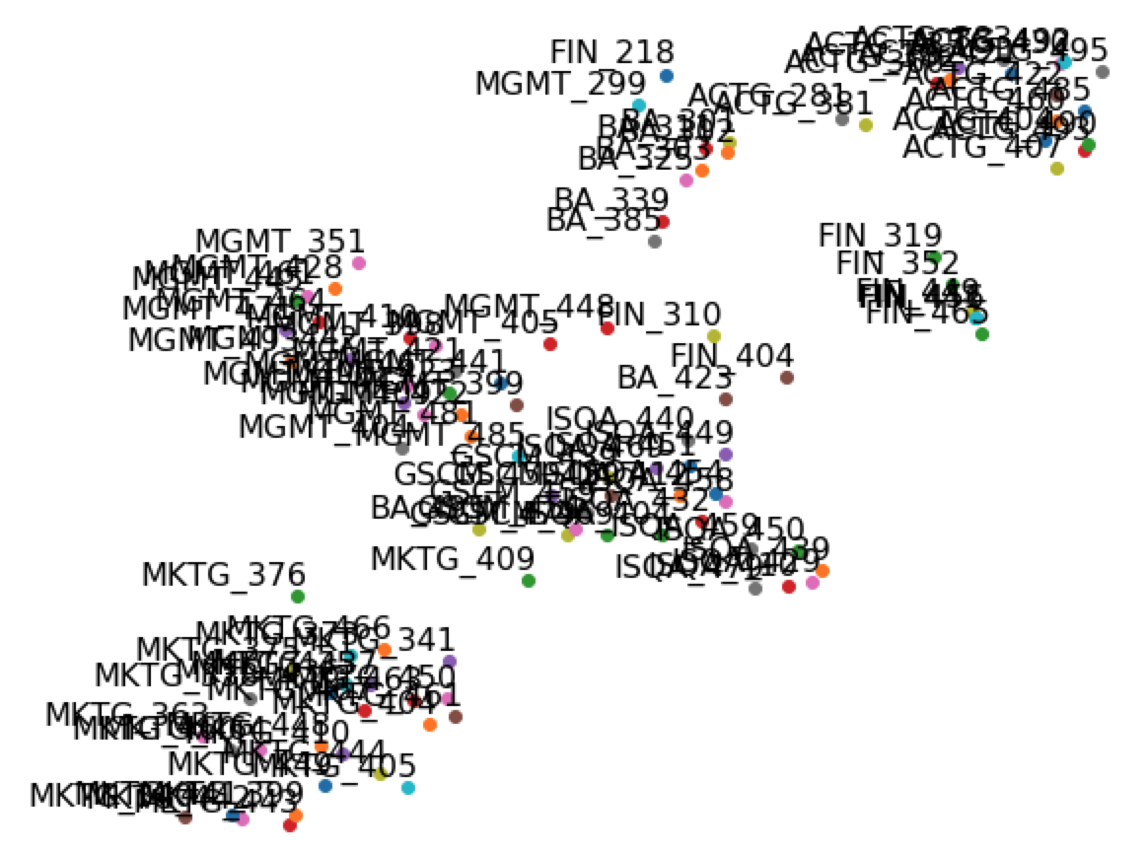

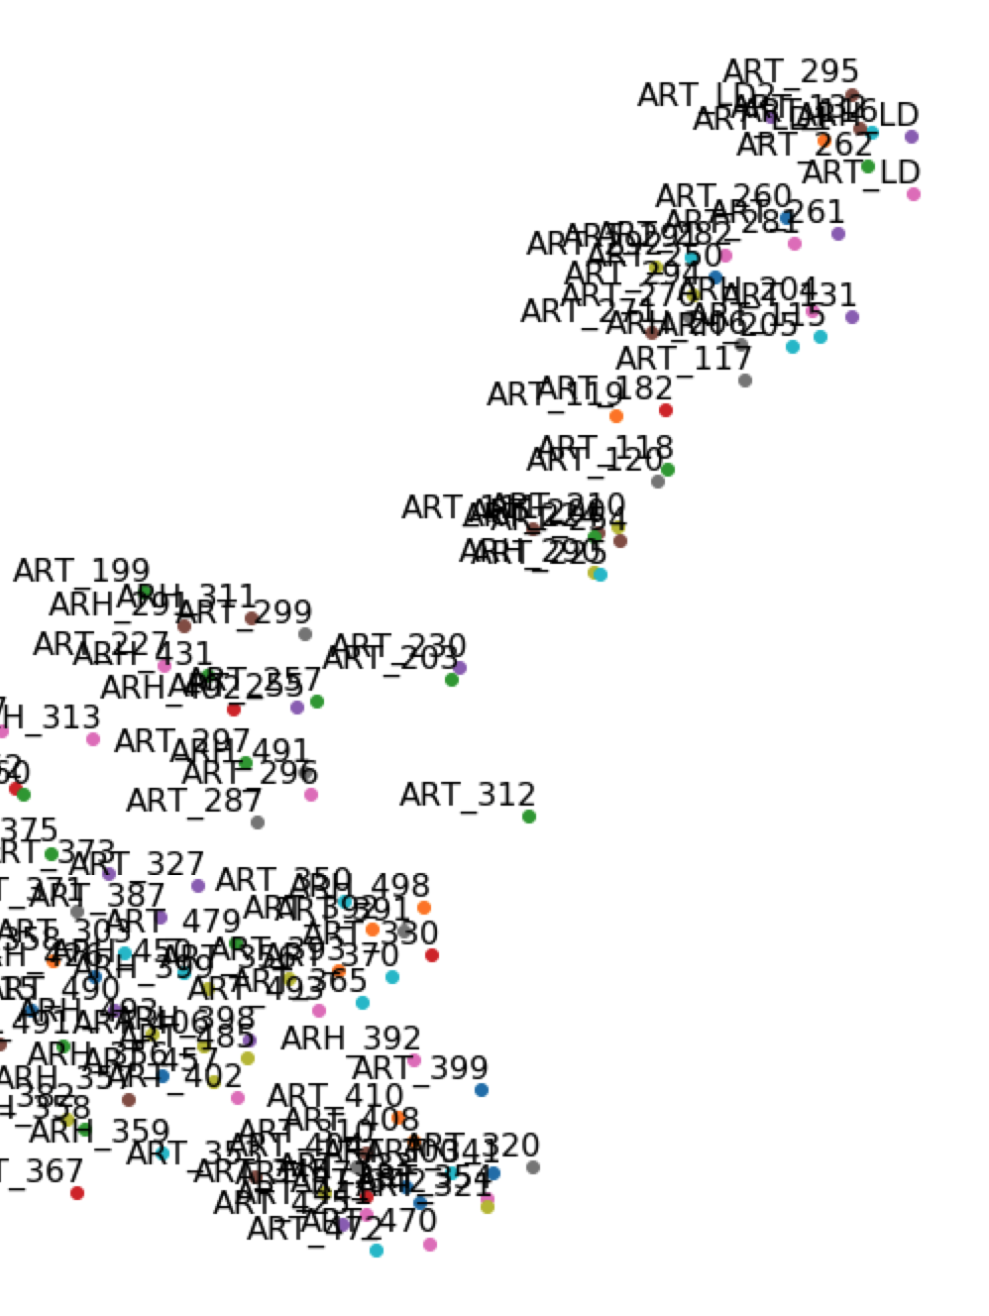
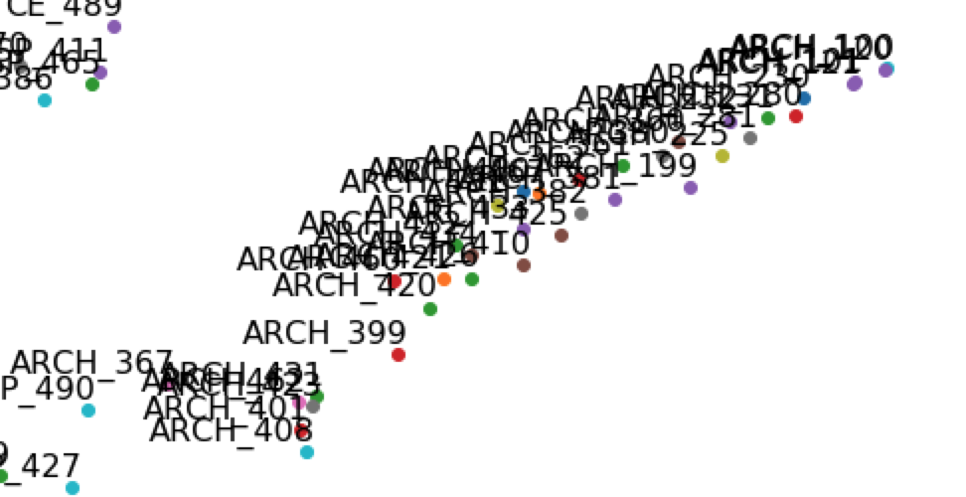
Course Embedding Space for PSU
SageMaker BlazingText algorithm on student pathways

Slide 22
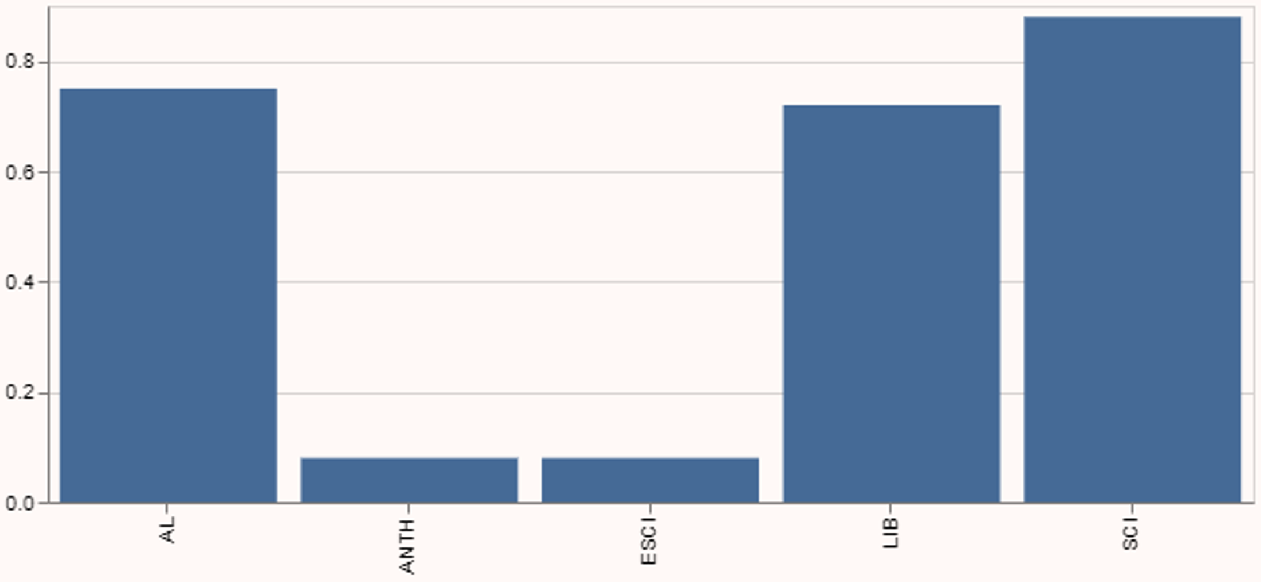






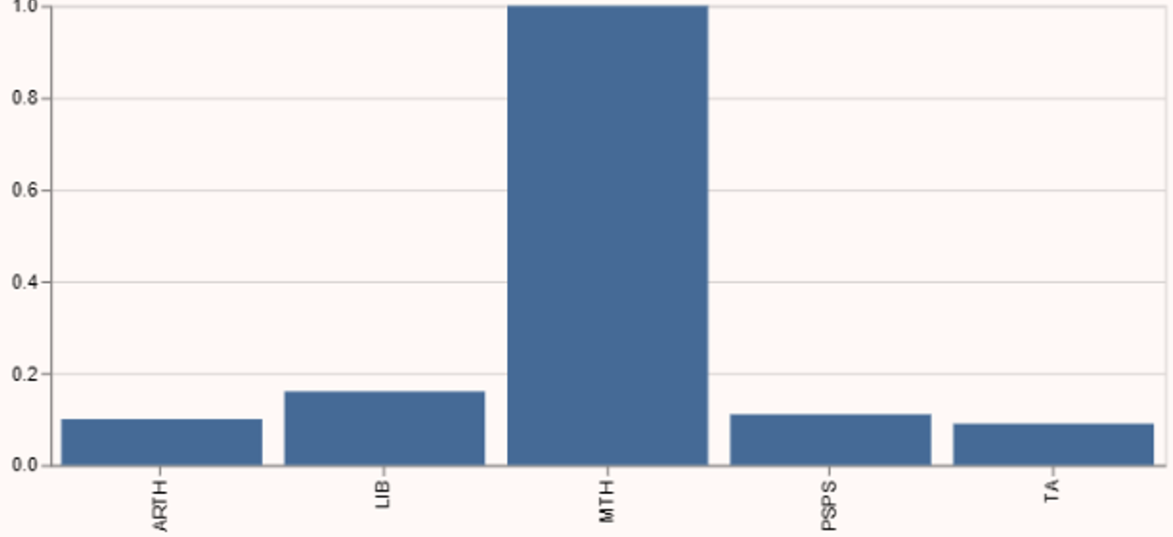
SageMaker Object2Vec Algorithm to Classify Majors
Delivered a functional demo application
Streamlit GUI
Exploratory Analysis & Model Training Orchestration
SageMaker Notebooks
Amazon S3
SageMaker
Training
Training Algorithm – Model File
End Users Interact with Streamlit
Amazon ECR
Model Artifact & Logic
AL Arts and Letters
ANTH Anthropology
ESCI Earth Science
LIB Liberal Studies
SCI Science
ARTH Art History
LIB Liberal Studies
MTH Mathematics
PSPS Political Sci: Public Service
TA Theater Arts

Slide 23
Healthcare – Patient outcome predictions
?
BUSINESS CHALLENGE
Pharmaceutical commercial teams need to prioritize physicians to market their drugs.
Prediction of outcomes of candidate patients indicates which patients could benefit from particular medications.
DATA
Insurance claims data purchased from data broker
Clinical health records purchased from data broker
MACHINE LEARNING APPROACH
NLP methods on Amazon SageMaker
Sequence of patient insurance claims codes predict outcomes

Slide 24
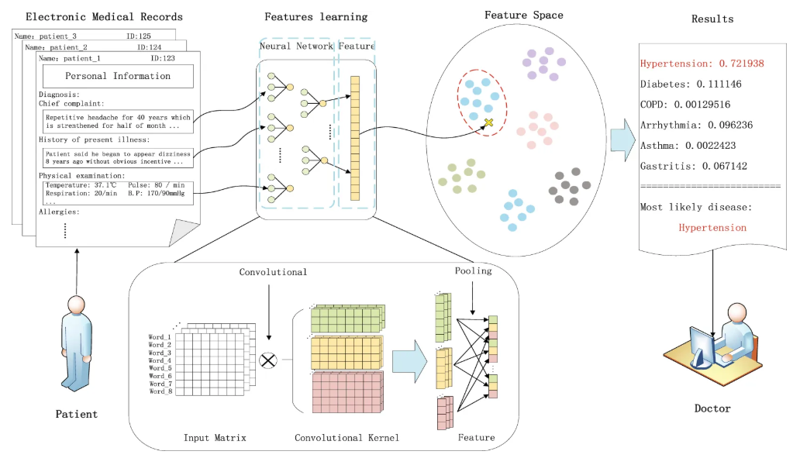
Medical Diagnoses Trained from Historical Data
Electronic Medical Record Based on Convolutional Neural Network. Sci Rep 8, 6329 (2018)

Slide 25





Medical events were combined with additional features for machine learning models
Additional features
Procedures
Plan tag
Provider tag
Site tag
Diagnoses
Selection from associated data
Features
Model
medical event features
Drugs
Procedure Embedding Features
Diagnosis
Embedding Features
Medical Events
Embeddings Generation
Medication
Embedding Features
Plan, provider, site

Slide 26
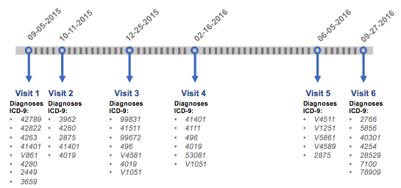
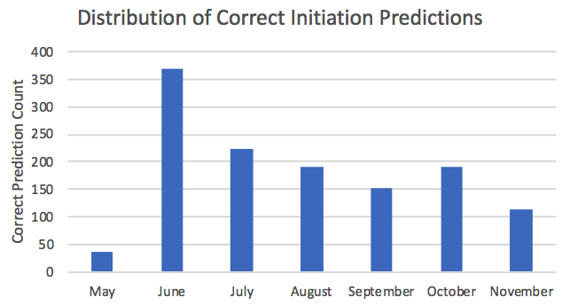
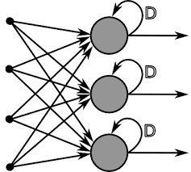
Deep Learning for Pharmaceutical Intervention
Predict the future use of treatment for disease to intervene.
Patient code history predicts events.
Deep Learning Model
Predicted time for biologic treatment
Intervention

Slide 27
Applied Mathematics in the Tech Industry
From small to big data
Natural Language Processing & Applications
Data Science in practice

Slide 28

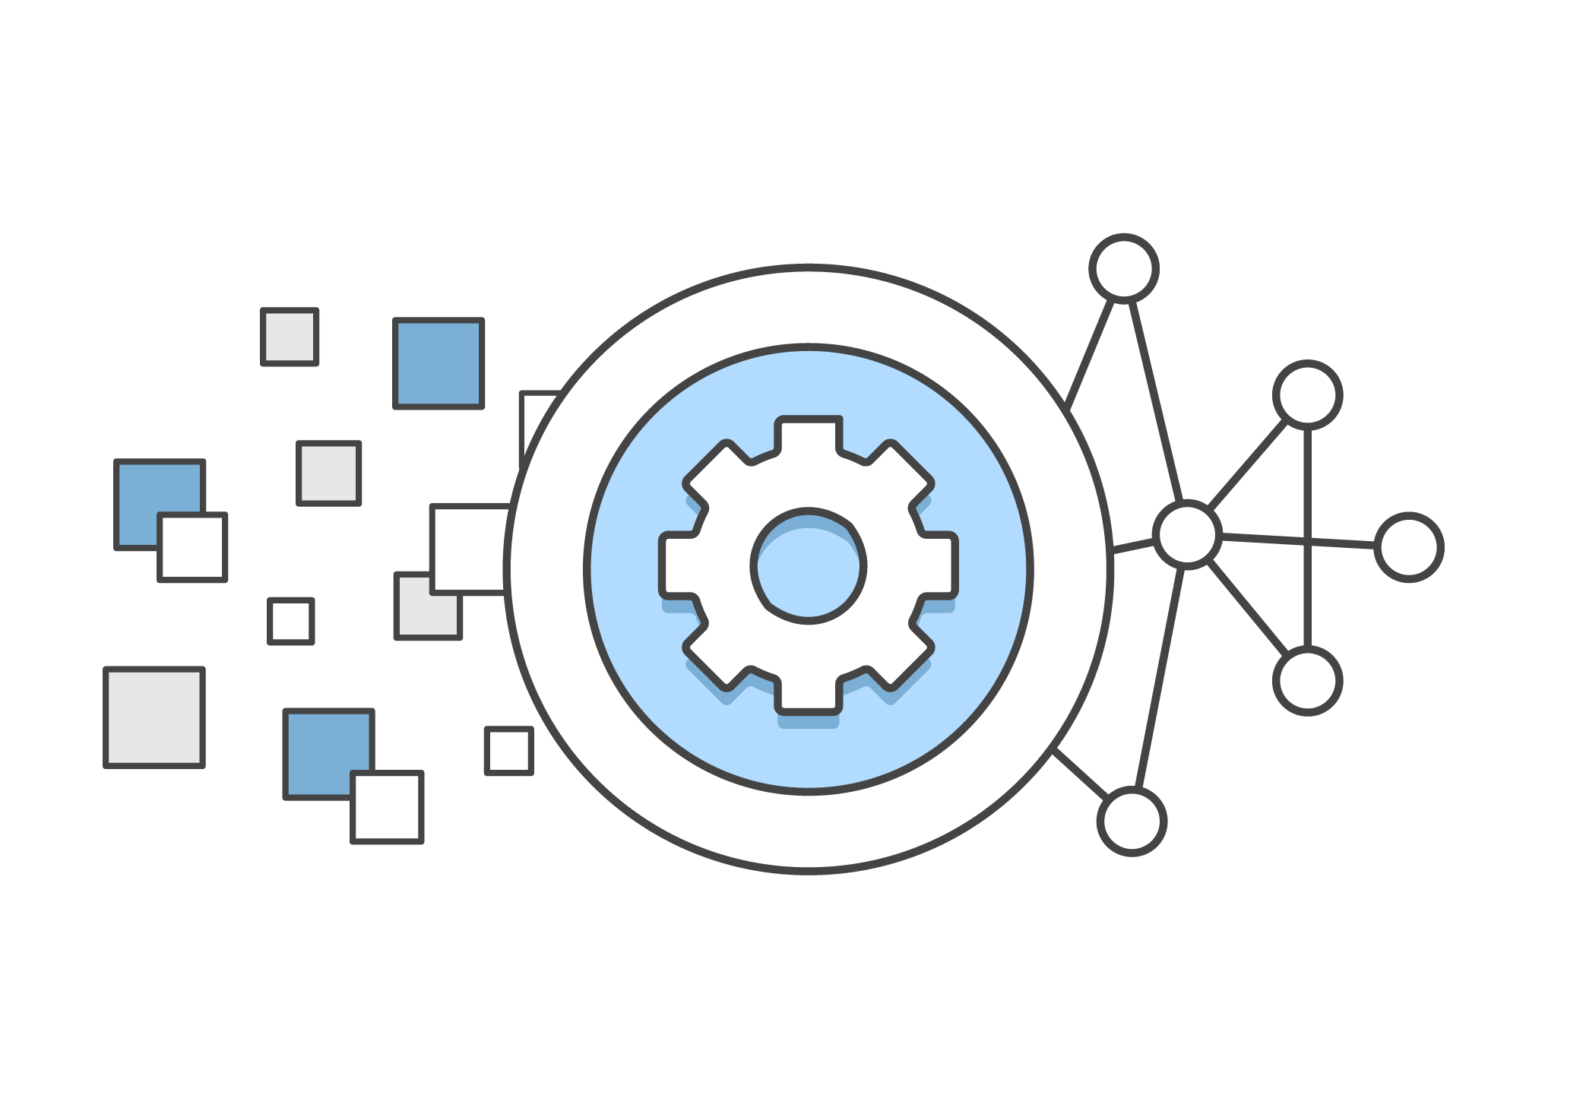
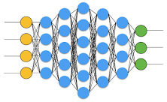
The Machine Learning Product
Automate decisions,
Predict outcomes,
Interpret language,
Interpret images,
Trigger actions,…
Data
Processing
Inference
Maintenance
Corrective: bugs, unexpected outcomes,…
Adaptive: retrain for changing data, update features,…
Perfective: improve performance & operations, reduce cost,…
Preventative: security, simplify, improve reliability,…
=> Continual improvements, continual updates

Slide 29







Data Scientist + ML Engineer
Goal: ML Data Pipeline
Business
Use Case
Data sources
Documents
Automation / Real-time
risk
$$$
$$
$
Transactions
Filter & Transform
Business forecasts
Logs / cookies
Data Lake
Storage | Archival Storage | Data Catalog
Devices
ML Algorithms
BI reports
Social media
Risk Management

Slide 30

Data Science and ML | Components
Data Selection
Data Prep
Model Selection
Model Training
Model Evaluation
Model Deployment
Data Selection
Data Cleansing
(Missing Values, Normalization, etc..)
Connectionists
(Neural Networks)
HPO
(Non-learned parameter tuning)
Symbolists
(Logic)
Clustering
Portability
Databases
(Join, Filter, etc..)
Cross Validation
(Generalization?)
Analogists
(SVMs)
Dim Reduce
(ID Salient Features)
Bayesians
(Graphical Networks)
Metrics
(Bias, Variance, F1 Score)
Classification
Ensembling
Evolutionists
(Genetic Agents)
Annotation
(Label the ground truth)
Regularization (Dropout, L2, etc..)
Boosters
(Boosted Trees)
Display
Regression

Slide 31
Open Problems and Challenges
Methods
Bias & Fairness Explainability
Convergence
Brittleness
Repeatability
Predictability
Ethical
Practice
People
Process
Product
Regulation

Slide 32
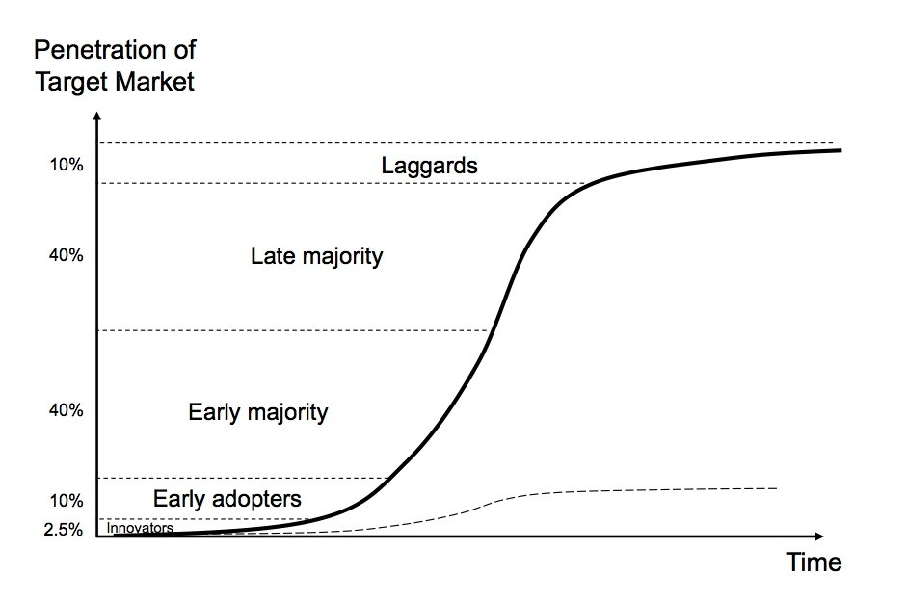
Machine Learning : The Analytics of Yesteryear
Machine learning today is finding more value in big data.
The few companies have a integrated ML competency and reaped the majority of the benefits.
We are reaching the point of mass adoption as companies realize the benefits of ML.
We are Here

Slide 33
Thank You

Slide 34
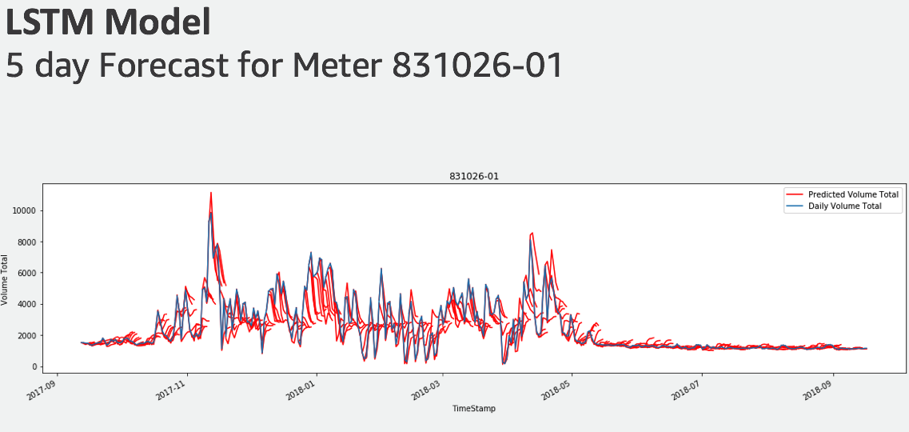
Energy – Daily Gas Volume Forecast for Distribution
?
BUSINESS CHALLENGE
MACHINE LEARNING APPROACH
Forecast 1-5 days of gas volume flow based on historical data to better regulate distribution network.
Recurrent Neural Network: LSTM in SageMaker
DATA
OUTCOMES
Daily volume total for 2013-2018
Weather data, high/low temperature, wind speed
Weather temperature forecast for 1 day
Endpoint location type, market area
Historical volume forecasts by customer for comparison
Model prediction for individual meters was similar in accuracy to historical forecast of whole system
ML enabled control of distribution points and improved regulation of overall system.

Slide 35

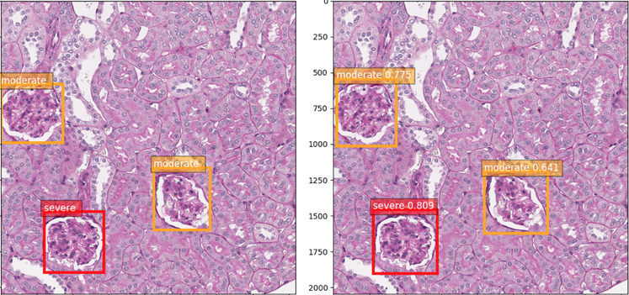
Kidney Injury Assessment for Clinical Trials
?
BUSINESS CHALLENGE
OUTCOMES
Kidney Injury Assessment for Preclinical Toxicity and Efficacy Studies using Computer Vision
Assess overall kidney injury, by locating and scoring all glomeruli each to a pre defined injury class.
Detection results were used to enable delivering faster time to scientific insight.
Assist manual assessment by increasing accuracy, reducing human errors and bias.
Reduce operational cost and free up pathologist.
DATA
Digital scanned kidney slice images, with annotation of glomeruli including location and injury class information, from customer’s diabetic study of mice kidneys.
MACHINE LEARNING APPROACH
Single Shot Multibox Detection (SSD), that detects objects in images, and the objects are categorized into one of the classes in the pre defined collection.
Ground Truth
Object Detection
Example labels and detection of injury in glomeruli imaging

Slide 36
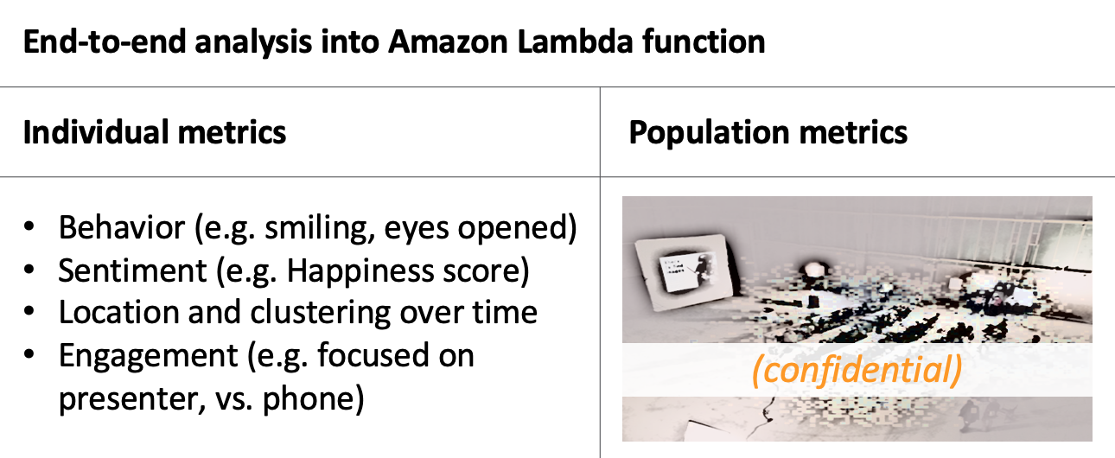
Technology – Real Time Workshop Analysis
?
BUSINESS CHALLENGE
OUTCOMES
Real Time Workshop Experience
Analyze behavior and reaction of workshop audience in real time to improve workshop experience.
Key audience metrics such as engagement and enthusiasm were used to distribute fun awards during the workshop and demonstrate AI capabilities to key clients.
End-to-end analysis of workshop audience in real time
In test simulations, provided real time tracking and analysis of audience both at individual and group levels.
DATA
Collection of ID-ed pictures of audience attendees
Real time video streaming (pre-recorded for testing purposes and real time during workshop delivery).
MACHINE LEARNING APPROACH
Amazon API service Rekognition, real time population heat mapping, sentiment analysis, and definition of engagement metrics based on linear algebra treatment of focus point, camera and tracked individuals.

Slide 37
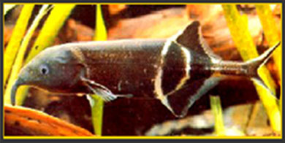
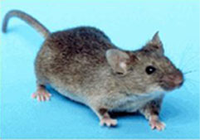
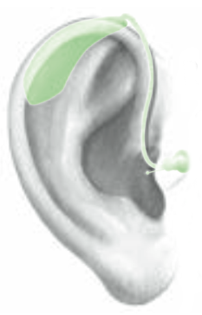

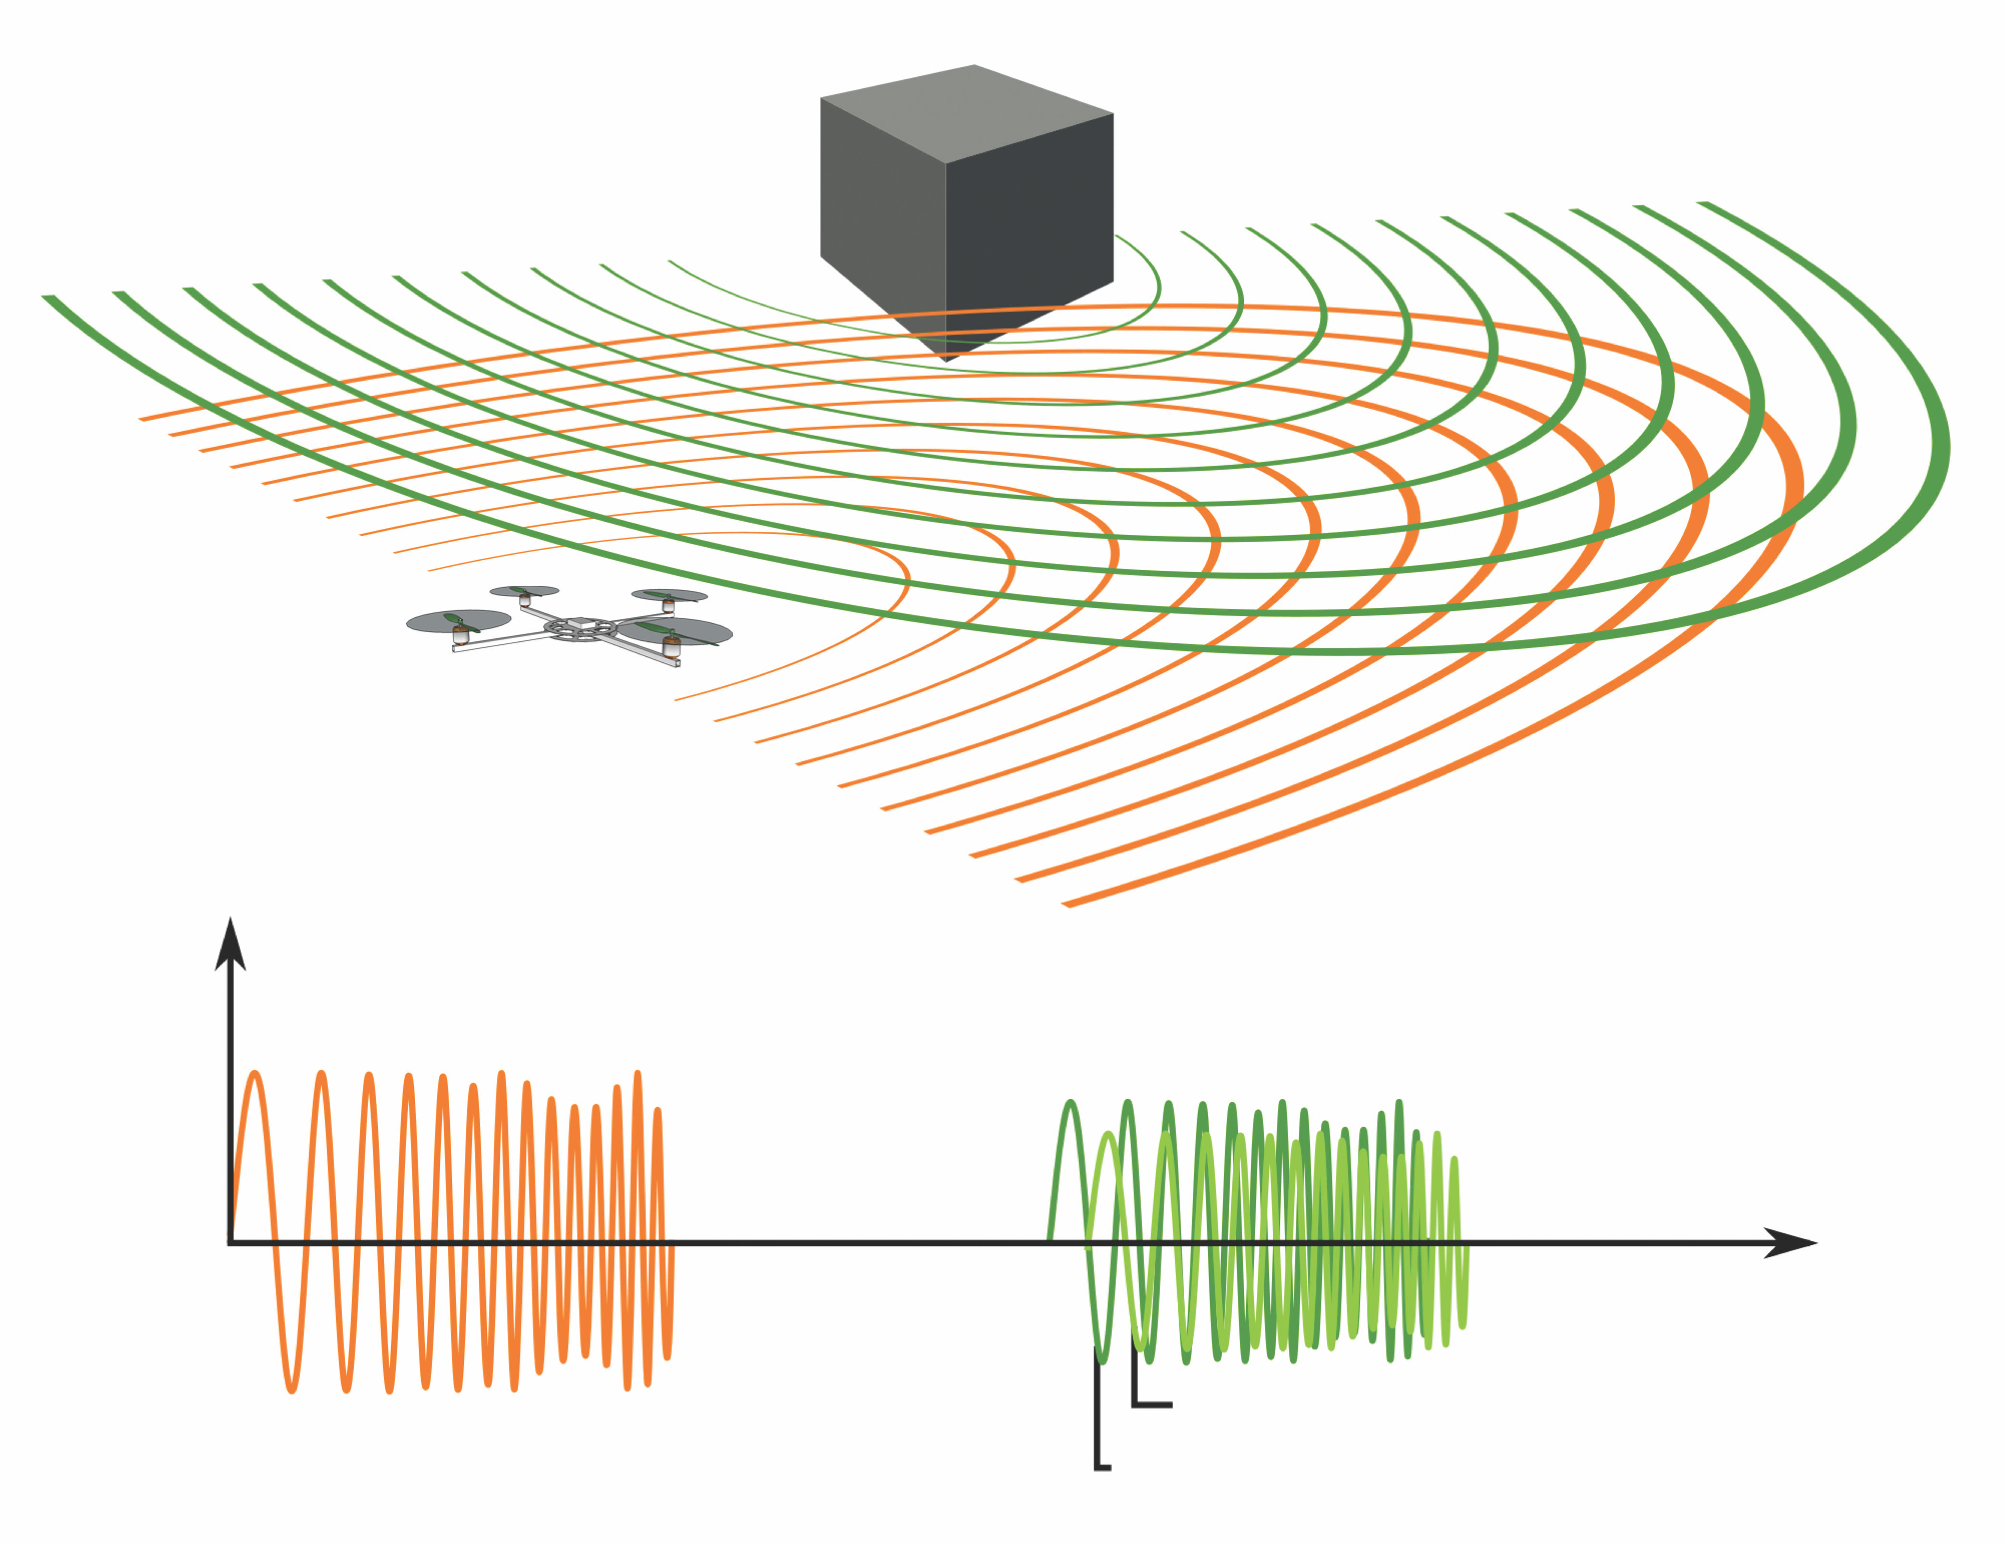



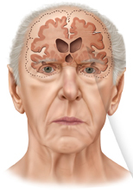


Academic Research
Auditory
Christine Portfors
Elena Mahrt**
Cameron Elde*
Amy Boyle
Richard Felix
Jeff Michael**
Kreg Jonson**
Lonneke Eeuwes
Zachery Mayko**
Laurence Trussell
Claudio Mello
Tarciso Velho**
Lars Holstrom**
James McNames
Electrosensory
Curtis Bell
Todd Leen
Alan Williams
Victor Han
Claudia Mohr
Jiamei Zhang
Dan Iancu**
Nathan Sawtell
Gerardo Lafferriere
Eran Agmon**
Gerhard von der Emde
Kunal Dalal*
Evan Vickers*
Cerebellum
Neal Barmack
Vadim Yakhnitsa
David Rossi
Gerhard Magnus
Vestibular
Gin McCollum
Bio-inspired Computing
Christof Teuscher
Jens Burger**
Amin Almassian**
George Lendaris
Roberto Santiago**
Retina
Rowland Taylor
Owen Gross*
Matthew Davidson*
Hippocampus
Matt Frerking
Andrew Toland**
In Silico Biosciences, Inc
Hugo Geerts
Athan Spiros
Cascadia Behav. Health.
James Conour
*undergradute, **graduate, OHSU, PSU, WSU, Reed, other

Slide 38
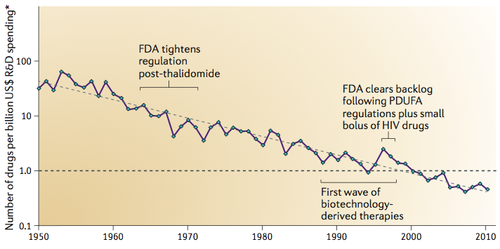
“Eroom’s Law” of Pharmaceutical Development
The cost of developing a new drug doubles every nine years.
Number of drugs per billion dollars has decreased exponentially for 60 years.
(Scannell, Blanckley, Boldon and Warrington, 2012)
“R&D costs are dominated by the cost of failure”

